Slide 1

Restaurant Management system

Slide 2


Since 2022
Just Feel The taste☺
www.Zira.com

Slide 3
Group Members
Harshbardhan Singh (Group Lead)
Abhishek Kumar
Vikalp Yadav
Alyan Jamal Qureshi
Manish Pramanik
Vishal Sharma
Anish Kumar Mishra

Slide 4
Introduction
Restaurant management system is a solution tool that is designed to track and maintain.
It manage all the data generated by a restaurant, including the orders of the customer, status of staff, records of orders placed, etc.
The restaurant management system is an automated version of manual management system.

Slide 5
Objective
The main objective of restaurant management system is to manage the details of User, Staff, Menu, Logins, Orders placed.
It manages all the information about Users, Staff, Order placed.
The project is totally built at administrative end and thus only the administrator is guaranteed the access.
To track the Orders and manage it.

Slide 6
Project Scope
Our project aims to safe and easy handling of staff and customers data. i.e. we have made a computerized process to store data and distribution.
It satisfies the admin.
It is easy and safe to store data.
Have a good user interface.
It helps the admin to handle the management of the restaurant.

Slide 7



Technologies and tools are used
FRONTEND:-
Angular
BACKEND:-
Java
Spring Boot
Spring Data JPA
DATABASE
Oracle

Slide 8
User Module
Home Page
Our services
Food Category
Reach us
Login Page
Signup Page
Menu Page
Food Page
Cart Page

Slide 9
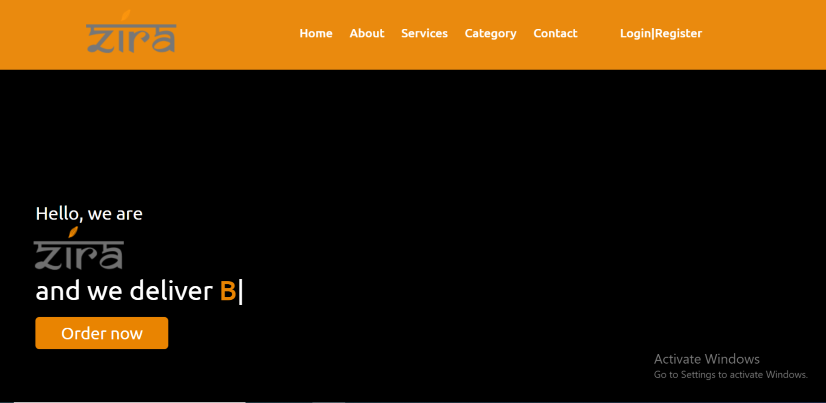
Home Page
This is the first page as the user clicks our link.

Slide 10
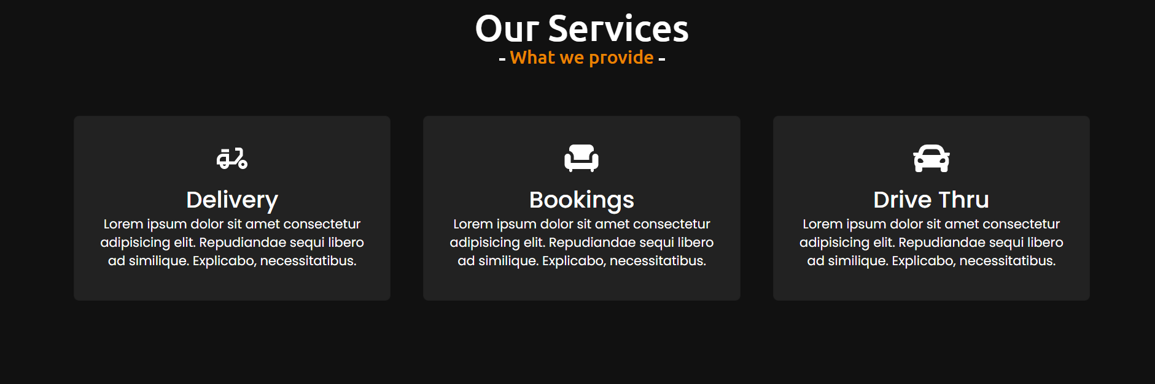
Our Services
These are some services provided by us.

Slide 11
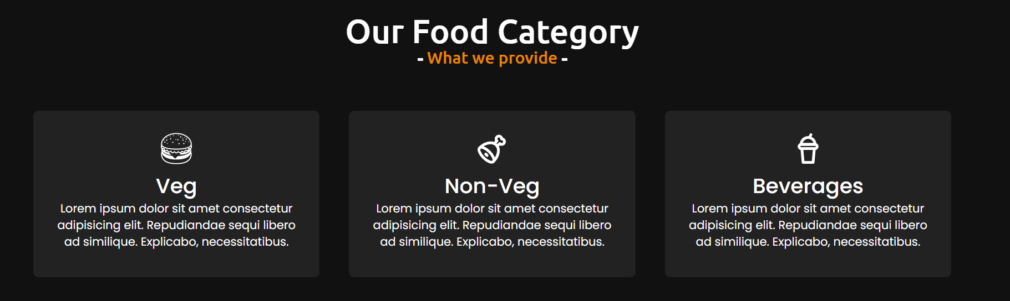
Food Category
Some of our food Categories are:-
Veg
Non-Veg
Beverages

Slide 12
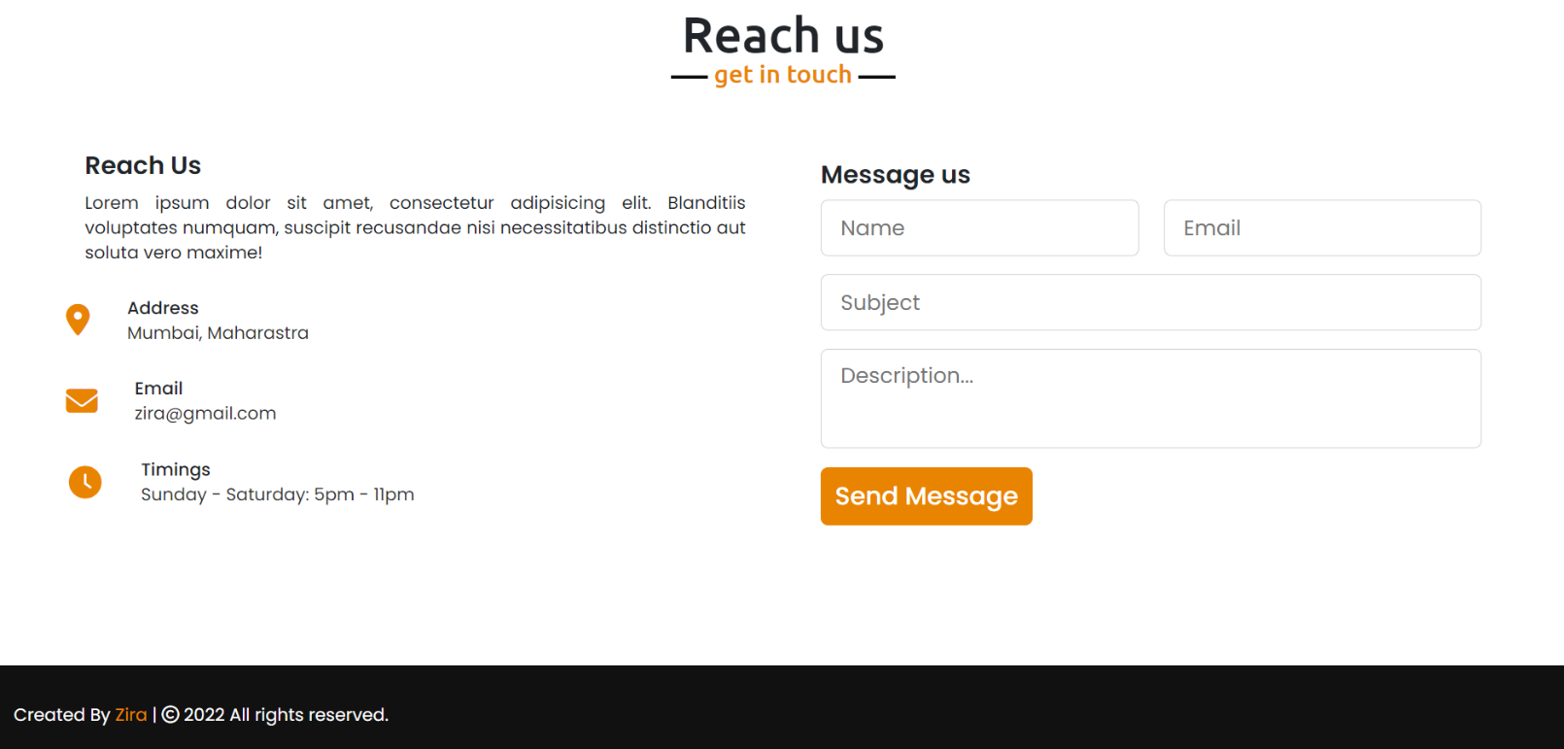
Reach us
For any help you can reach us by sending a message here.

Slide 13
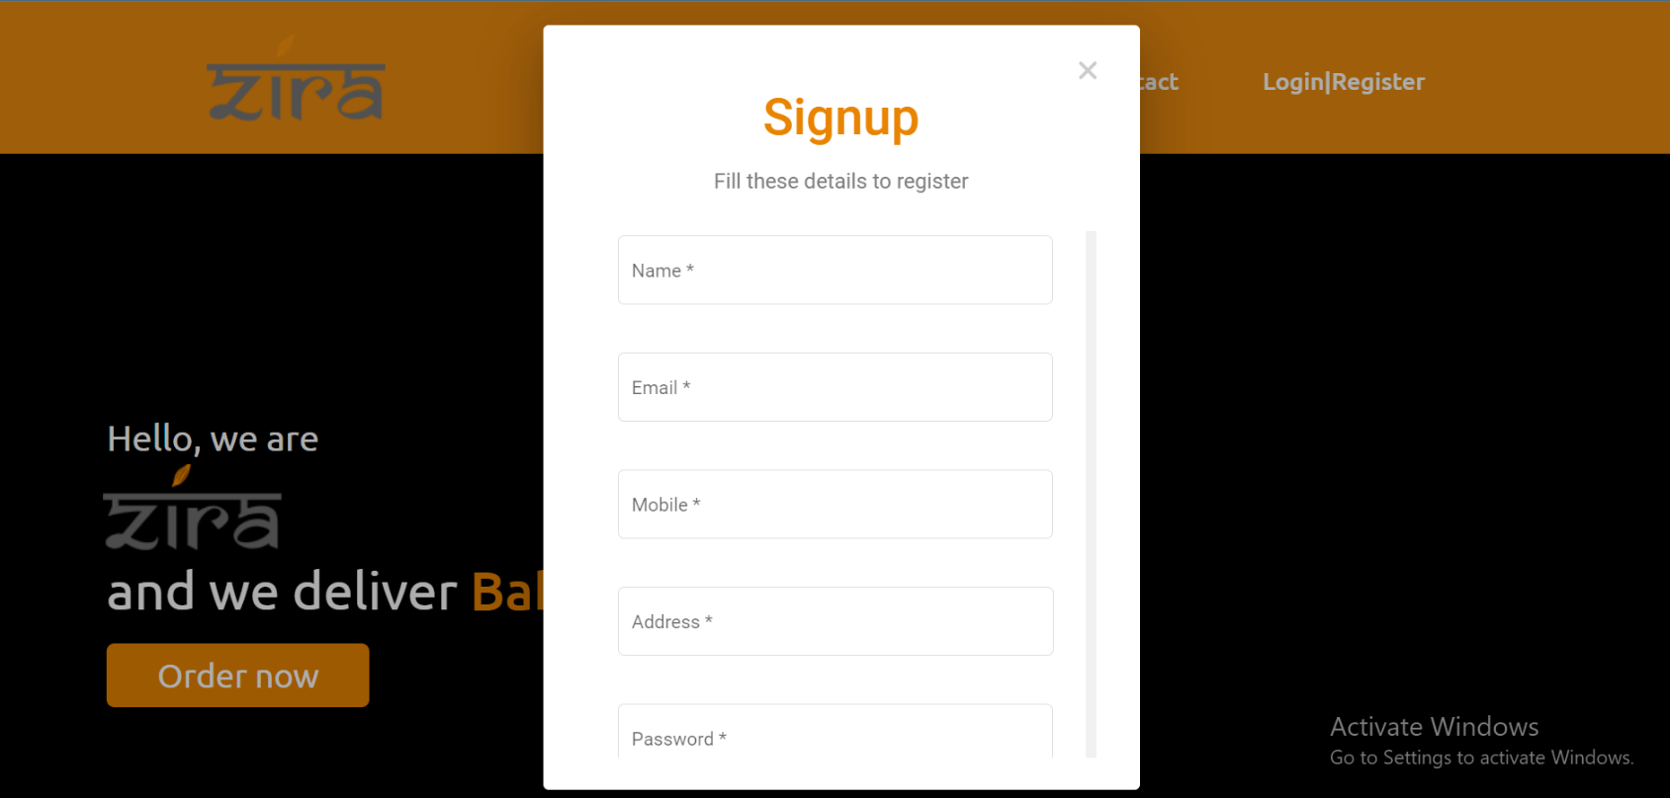
Signup page
A new user can sign-up here.

Slide 14
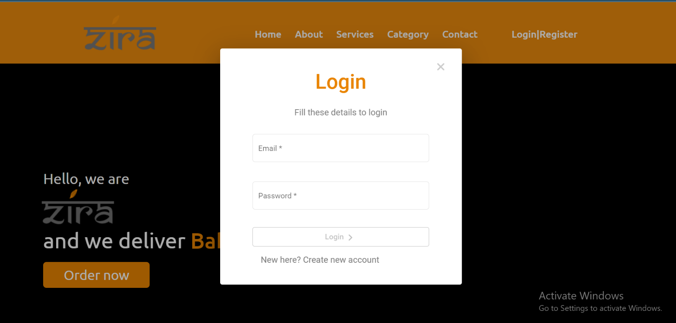
Login Page
User can not Login with wrong credentials.

Slide 15
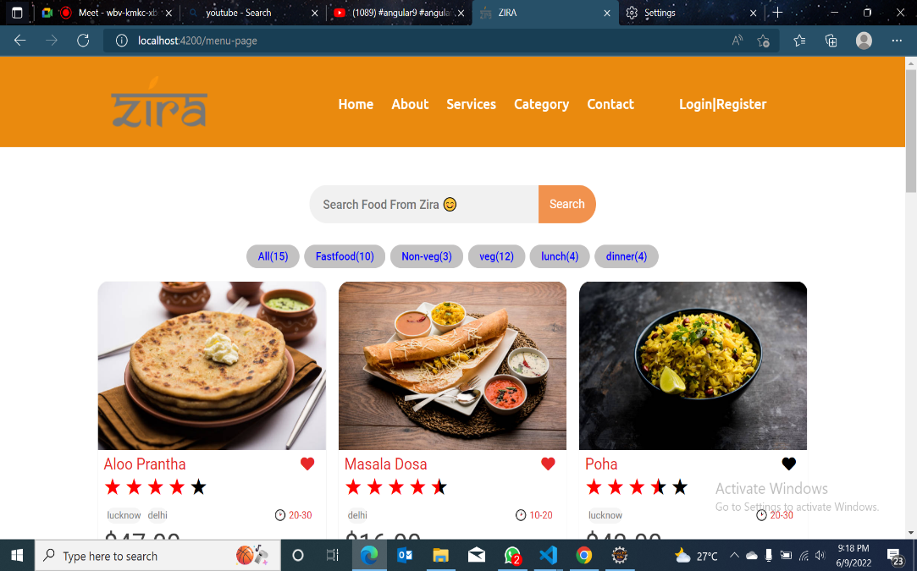
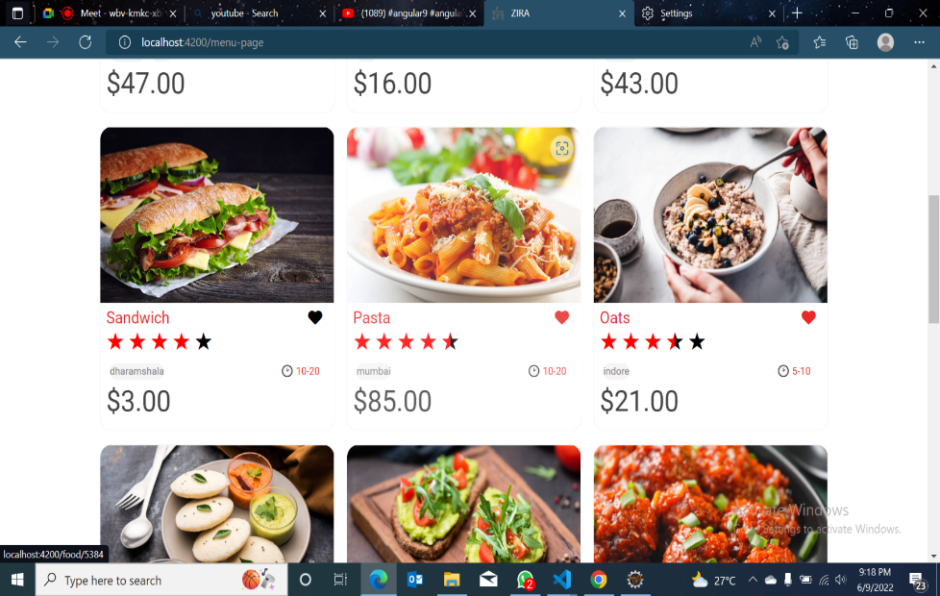
Menu

Slide 16
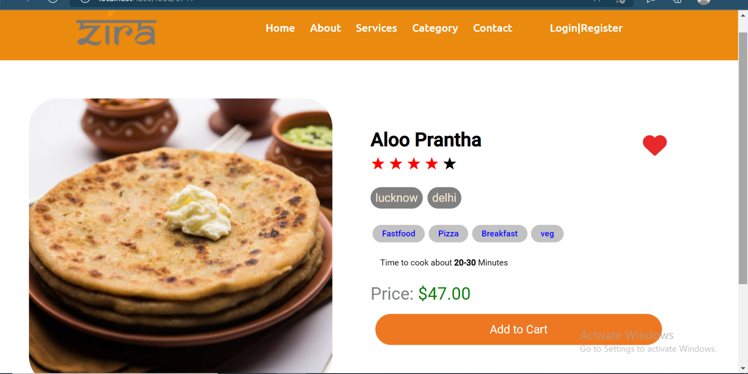
By clicking on add to cart user can add the preferred dish to his/her cart.

Slide 17
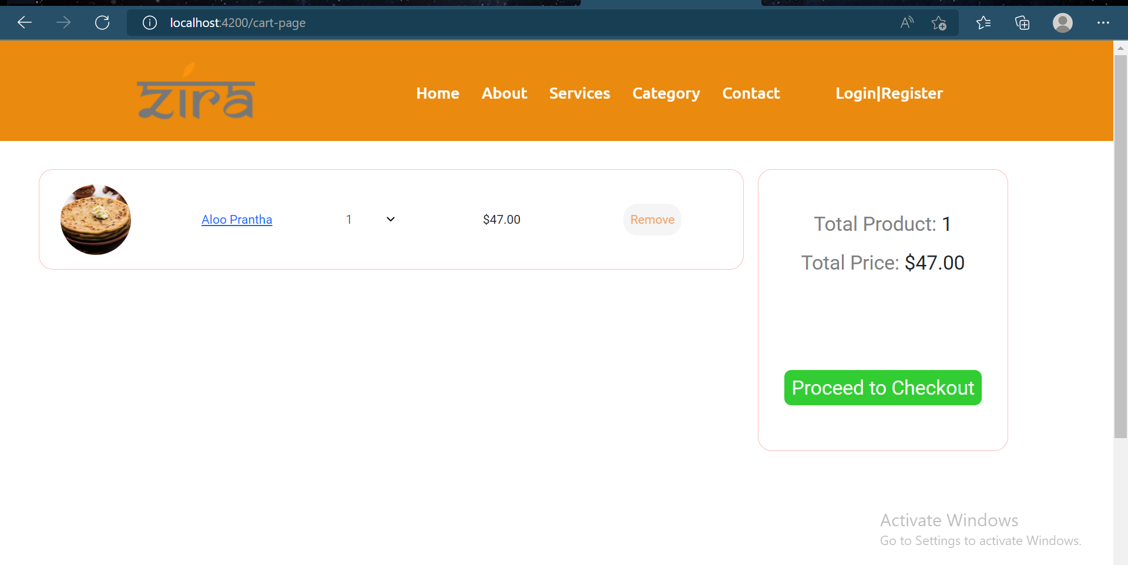

Slide 18
Admin Module
Dashboard
Staff List
Update Form
Menu List
Add Menu
Inventory List
Supplier List
Booking List

Slide 19
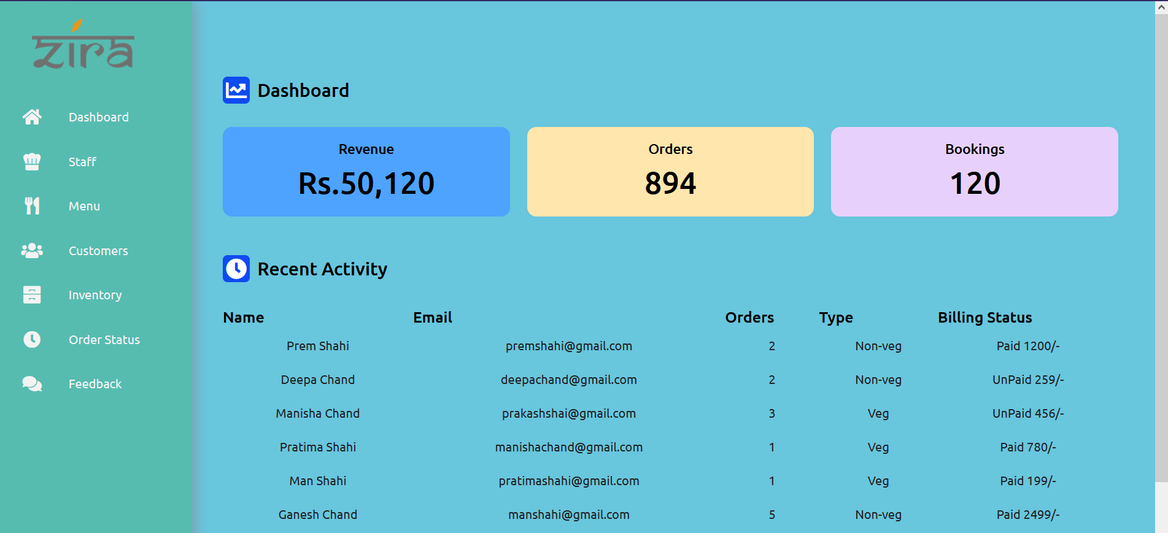
Dashboard
This is the ADMIN dashboard
Being in Remote ‘ADMIN’ can manage his/her restaurant through this page.

Slide 20
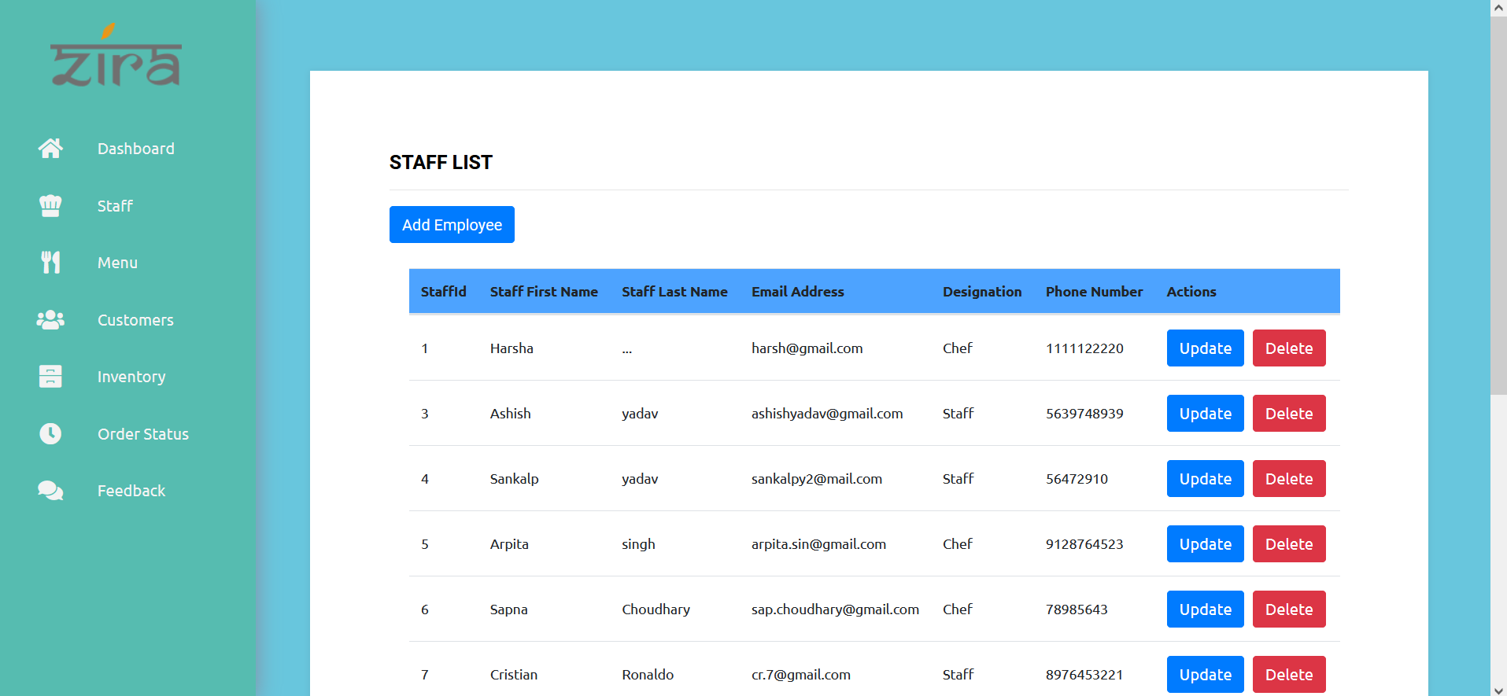
Staff List
We can update and delete Staff record through this page.

Slide 21
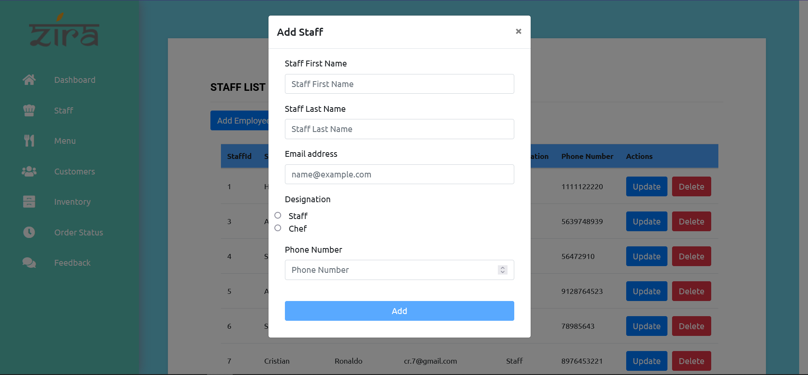
Add Staff
This is an add staff form.

Slide 22
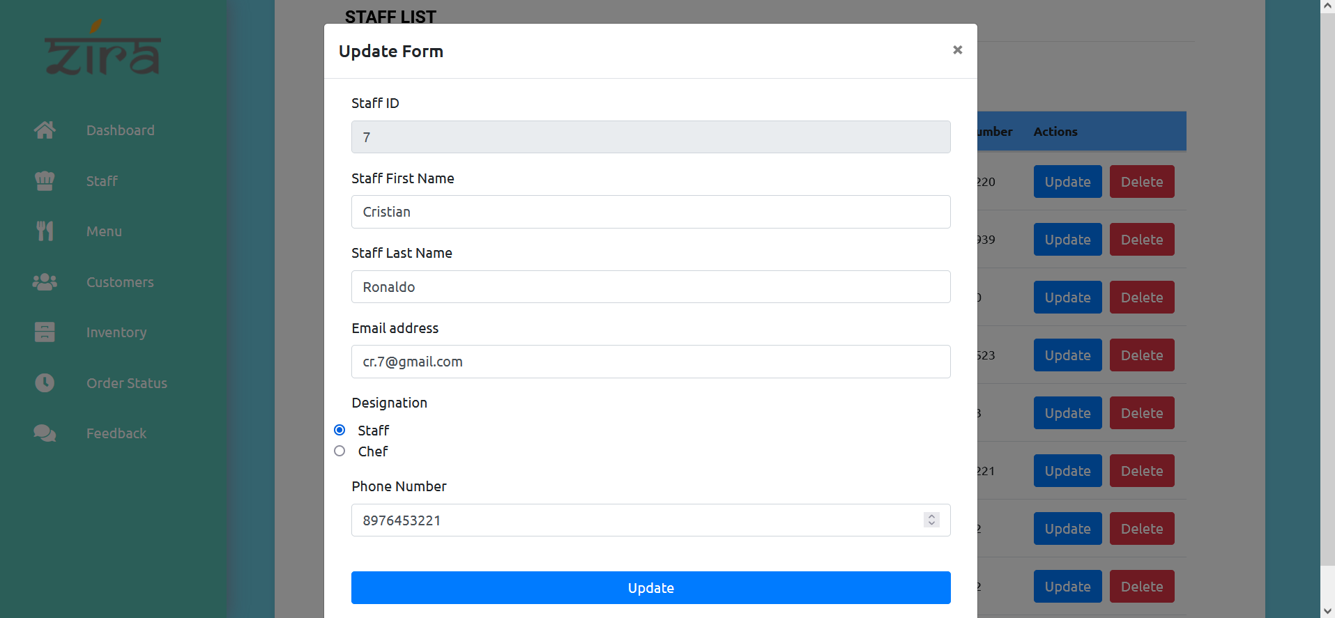
Update Form
This is an update Staff form .

Slide 23
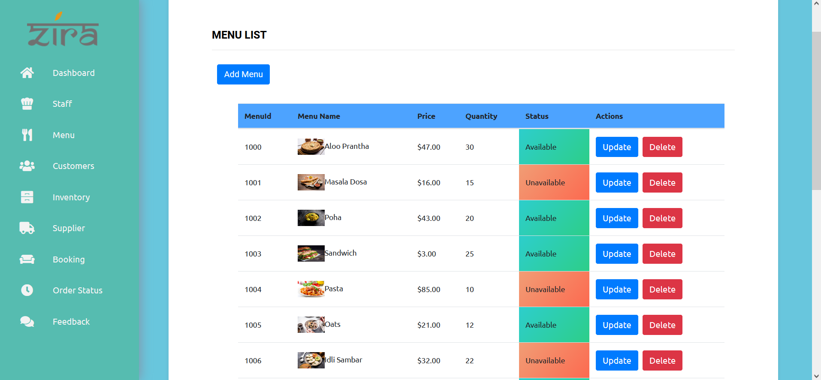
Menu List
This page is used for making changes in Menu.

Slide 24
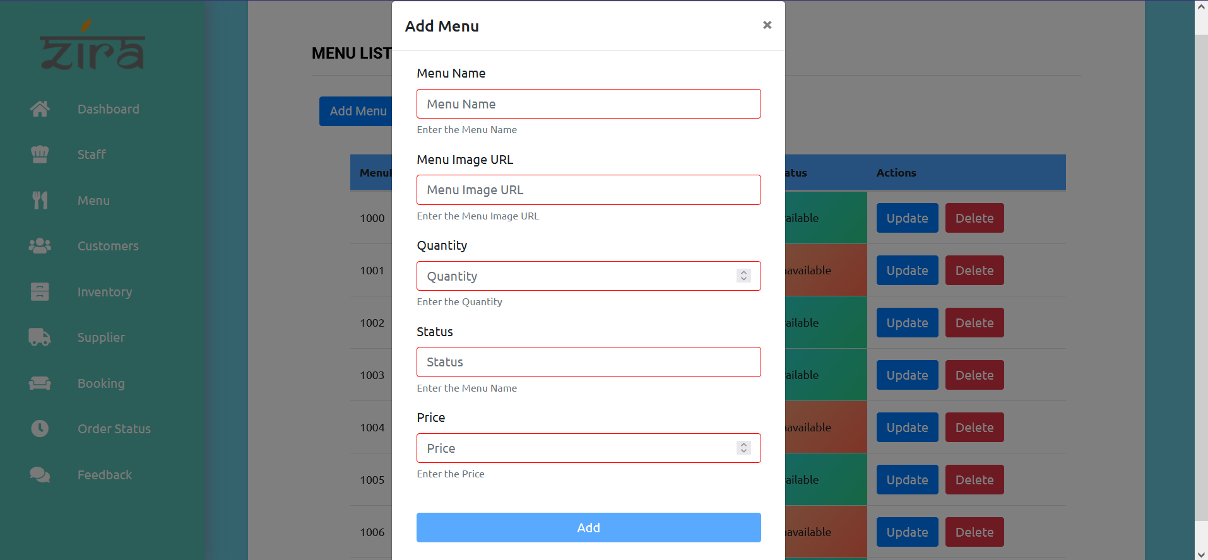
Add Menu
This is an add Menu form.

Slide 25
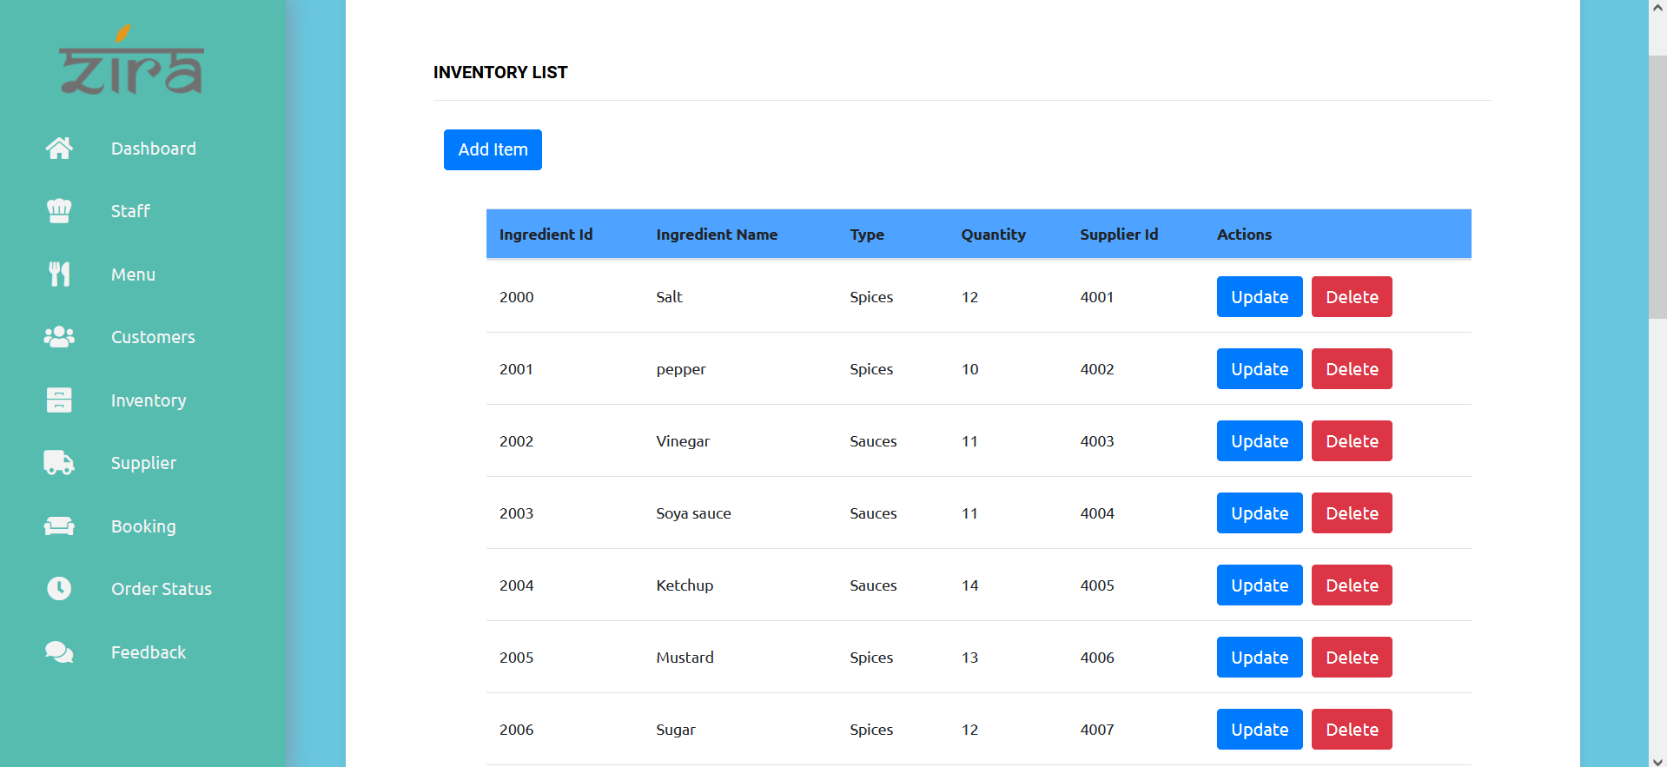
Inventory List
Same as other pages we have Inventory page to update and delete data of restaurant resources.

Slide 26
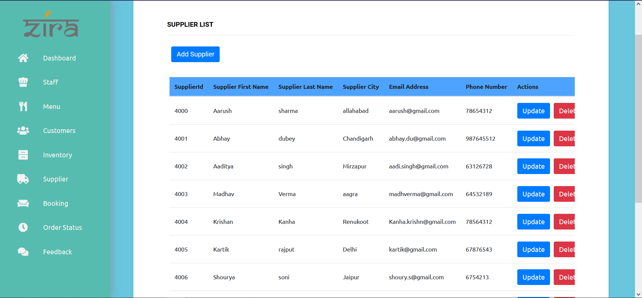
Supplier List
We have a Supplier List for the Admin to manage the data of suppliers who provide goods to the restaurant.

Slide 27
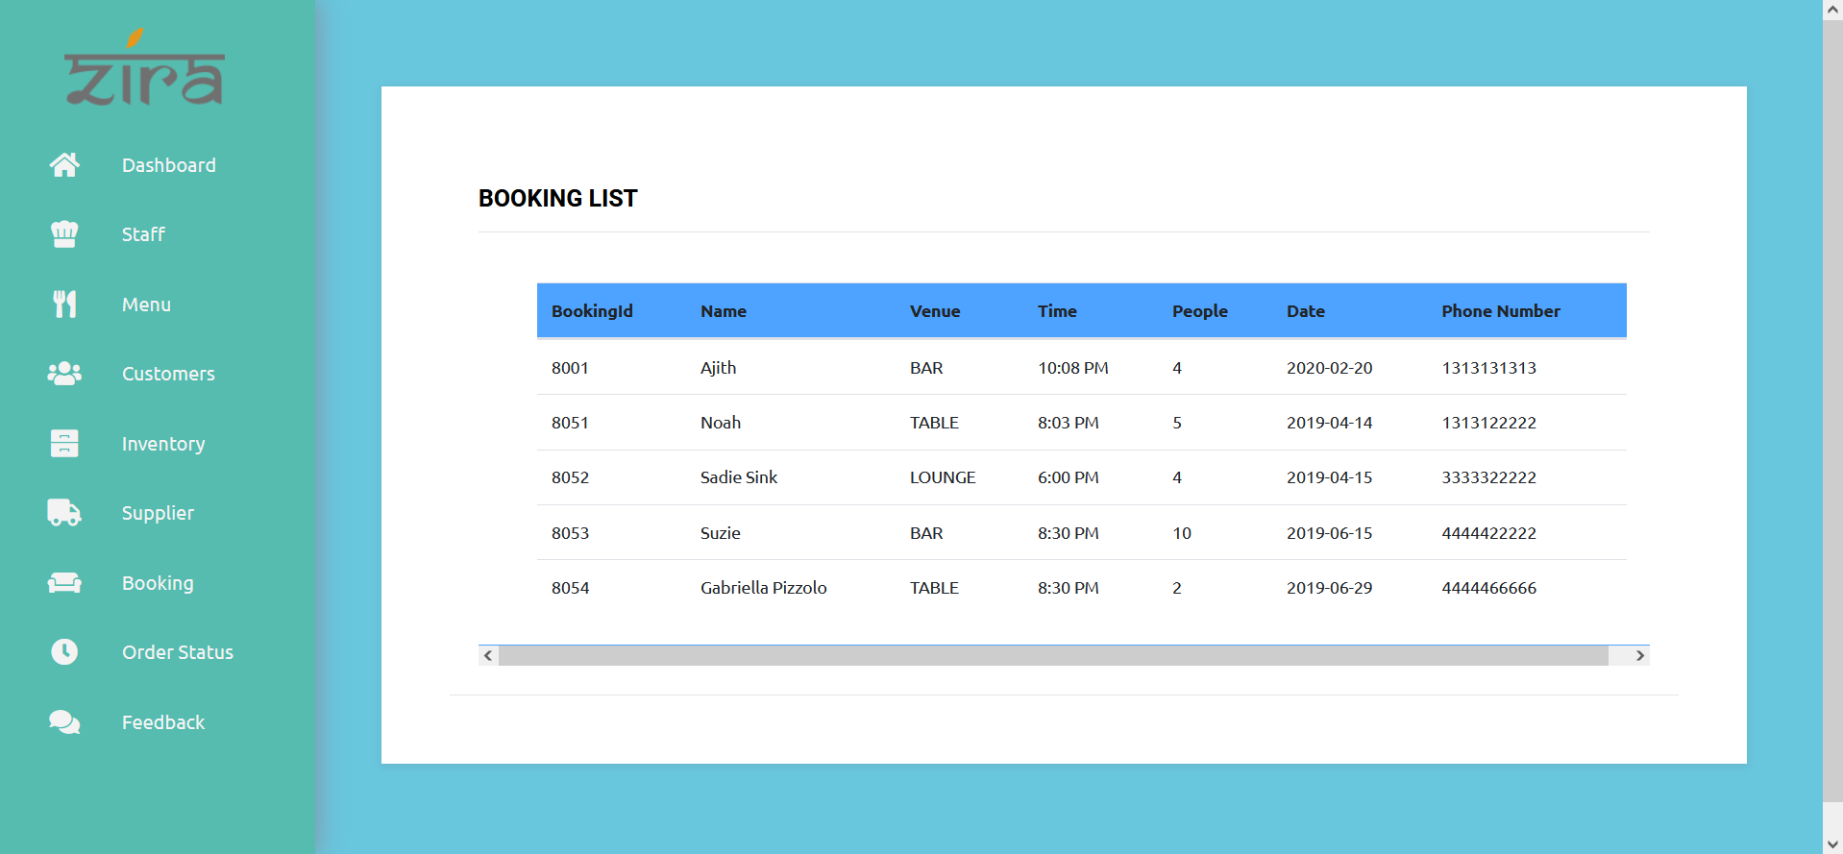
Booking List
This booking page shows the data of booked costumers.

Slide 28


